Slide 1


Foresee your movie revenue
Inspiring data scientist
Gary Kao

Slide 2

Movie business ≠ Guaranteed profit
Is the probability of making a profitable movie
similar to flipping a coin???
https://sciencelens.co.nz/2012/06/01/flip-a-coin-day/

Slide 3
How to tackle this problem?
Step 1
Step 2
Step 3
Preprocess
raw data
Explore
insights
Modeling
& results
Data wrangling
Storytelling
&
Inference
Classification
models

Slide 4
Data source & feature classification
IMDB movie dataset
Observation: 5043 movies
Features: 28 variables
Predictor variables
People information:
director
actor
Descriptive information:
color
duration
movie_title
facenumber_in_poster
plot_keywords
aspect_ratio
content_rating
title_year
language
country
genres
movie_imdb_link
Response variables
name
$$$:
gross
budget
revenue
Social media information:
Director
Major actors
Cast
Movie
Facebook likes
IMDB information:
IMDB score
Critic for reviews
User for reviews
Voted users
number

Slide 5
Data wrangling
[Cleaning step]
Checking the percentage of missing values in each variable (column) and observation (row)
It tells me how to prioritize the recovery steps
Duplicates removal
[Categorical variables]
Proofread ‘’movie title” column
Remove unnecessary words and spaces
Manually fix “color”, “country”, “language” columns
Fill up NaN values
Use one hot encoding
“content_rating” column
Remove TV series
Fill in NaN by web scraping (However, scraped data shows most of them are TV-series or Not rated. I would just skip the fill-in)
Group them into 4 and dummify them
Dummify “genres” column
Replace “Actor_name” and “director_name” columns into frequency

Slide 6
Data wrangling
[Numeric variables]
Fill in "title_year" column by web-scraped data and subgroup it
Fill in "budget" column with web-scraped data
Fill in "gross" column” with web-scraped data
Add “month” column by web-scraped data
Impute "num_critic_for_reviews", "director_facebook_likes", "actor_3_facebook_likes", "actor_1_facebook_likes", "facenumber_in_poster", "actor_2_facebook_likes", "aspect_ratio", "duration", "num_user_for_reviews" columns with median
[Final steps]
Remove “movie_imdb_link” column
Remove all rows with NaN
Save it to ‘final_wrangle.csv’

Slide 7
Data preprocessing
[Prepare target variable: revenue]
Create a new column called ‘revenue’ by ‘gross’ - ‘budget’
Change its unit to 1 million
[Outliers]
Use seaborn.pairplot to get histograms of all predictive variables
Check target variable
[High correlation between each predictor]
Create a correlation heatmap
Identify high positive and low negative correlation between variables
Remove the variable which is highly related to the other variable positively or negatively
[Save the preprocessed data]
final_pre.csv

Slide 8
Data storytelling & Data inference
[Strategy for numerical features]
Here I use simulated null hypothesis to test the significance (p-value) between each predictor and the revenue.
module.py includes functions:
‘pearson_permuttion_plot’ for null hypothesis simulation, p-value calculation, and plotting
[Strategy for categorical features]
Here I calculate the mean difference between the categories and test it with simulated null hypothesis.
module.py includes functions:
‘mean_diff_testing’ for plotting
‘mean_diff_p’ for calculating p-value between different means

Slide 9
Is IMDB score a good indicator of the revenue?
The correlation is 24% and significant.

Slide 10
How reviews affect the revenue?
[Correlation & significance]
Voted users: 49%, significant
Users for reviews: 38%, significant
Critics for reviews: 24%, significant

Slide 11
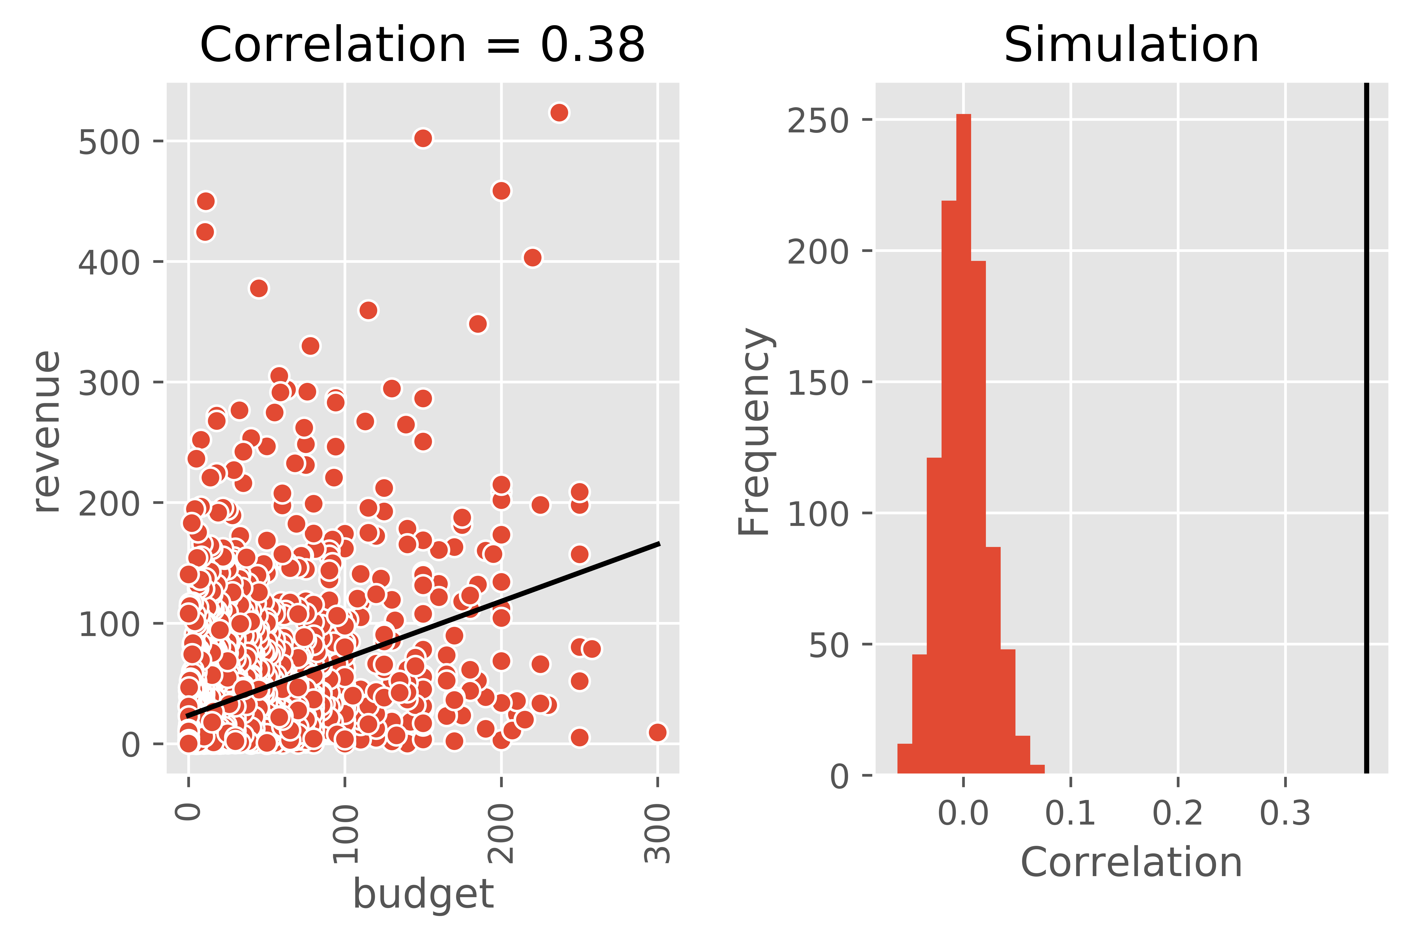
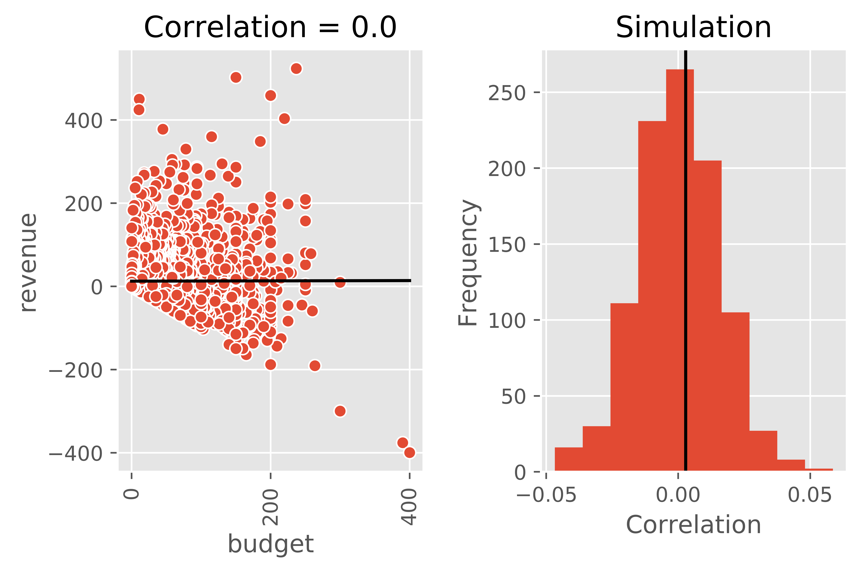
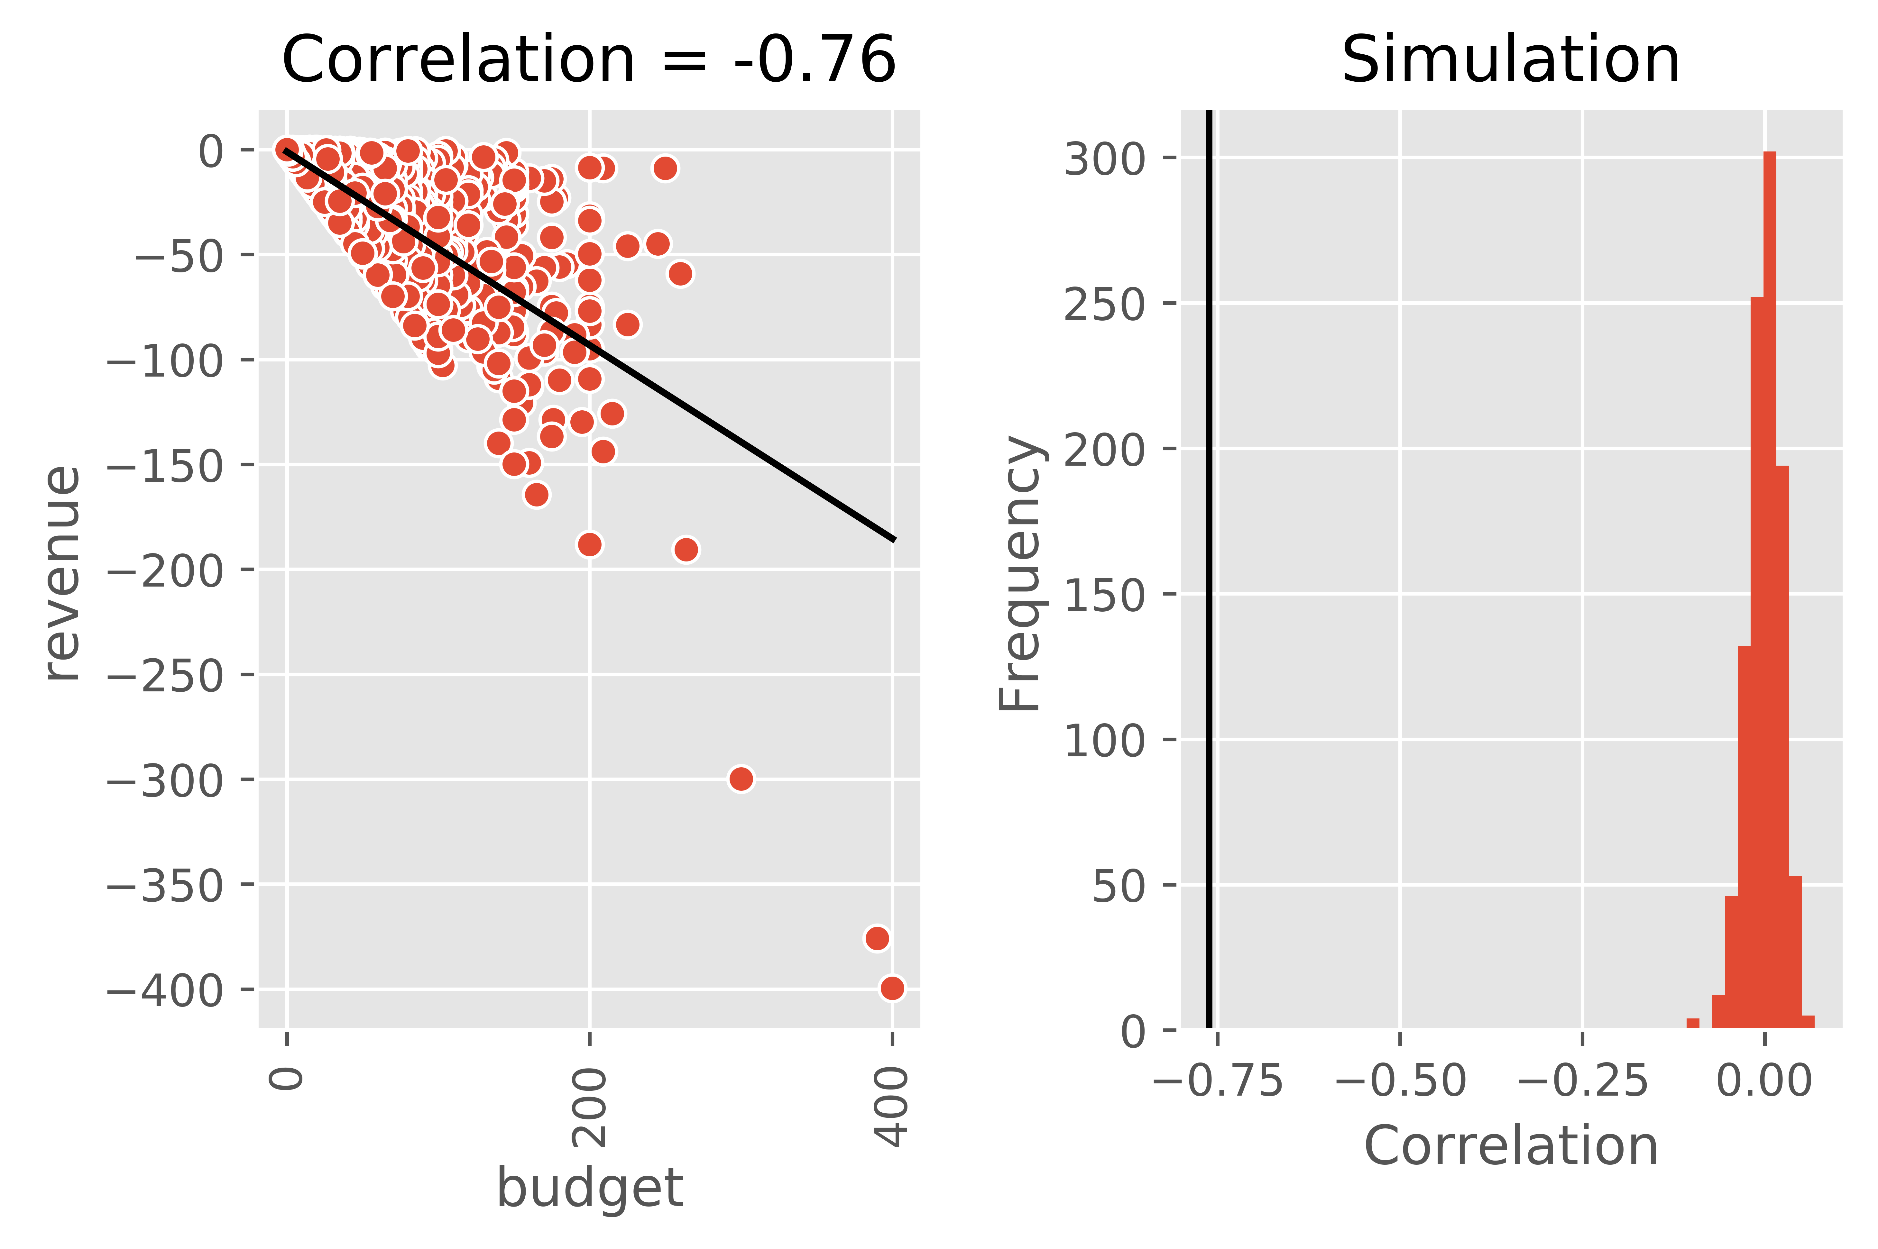
Is the budget correlated to the revenue? Invest more, earn more back?
1. No correlation between the total budget and revenue.
2. Positive and Negative revenue has correlation with budget, perspectively
Total budget
Positive
revenue
Negative
revenue
Recommendation:
There is a trend that most of failed movies (negative revenue) are supported by a big budget

Slide 12
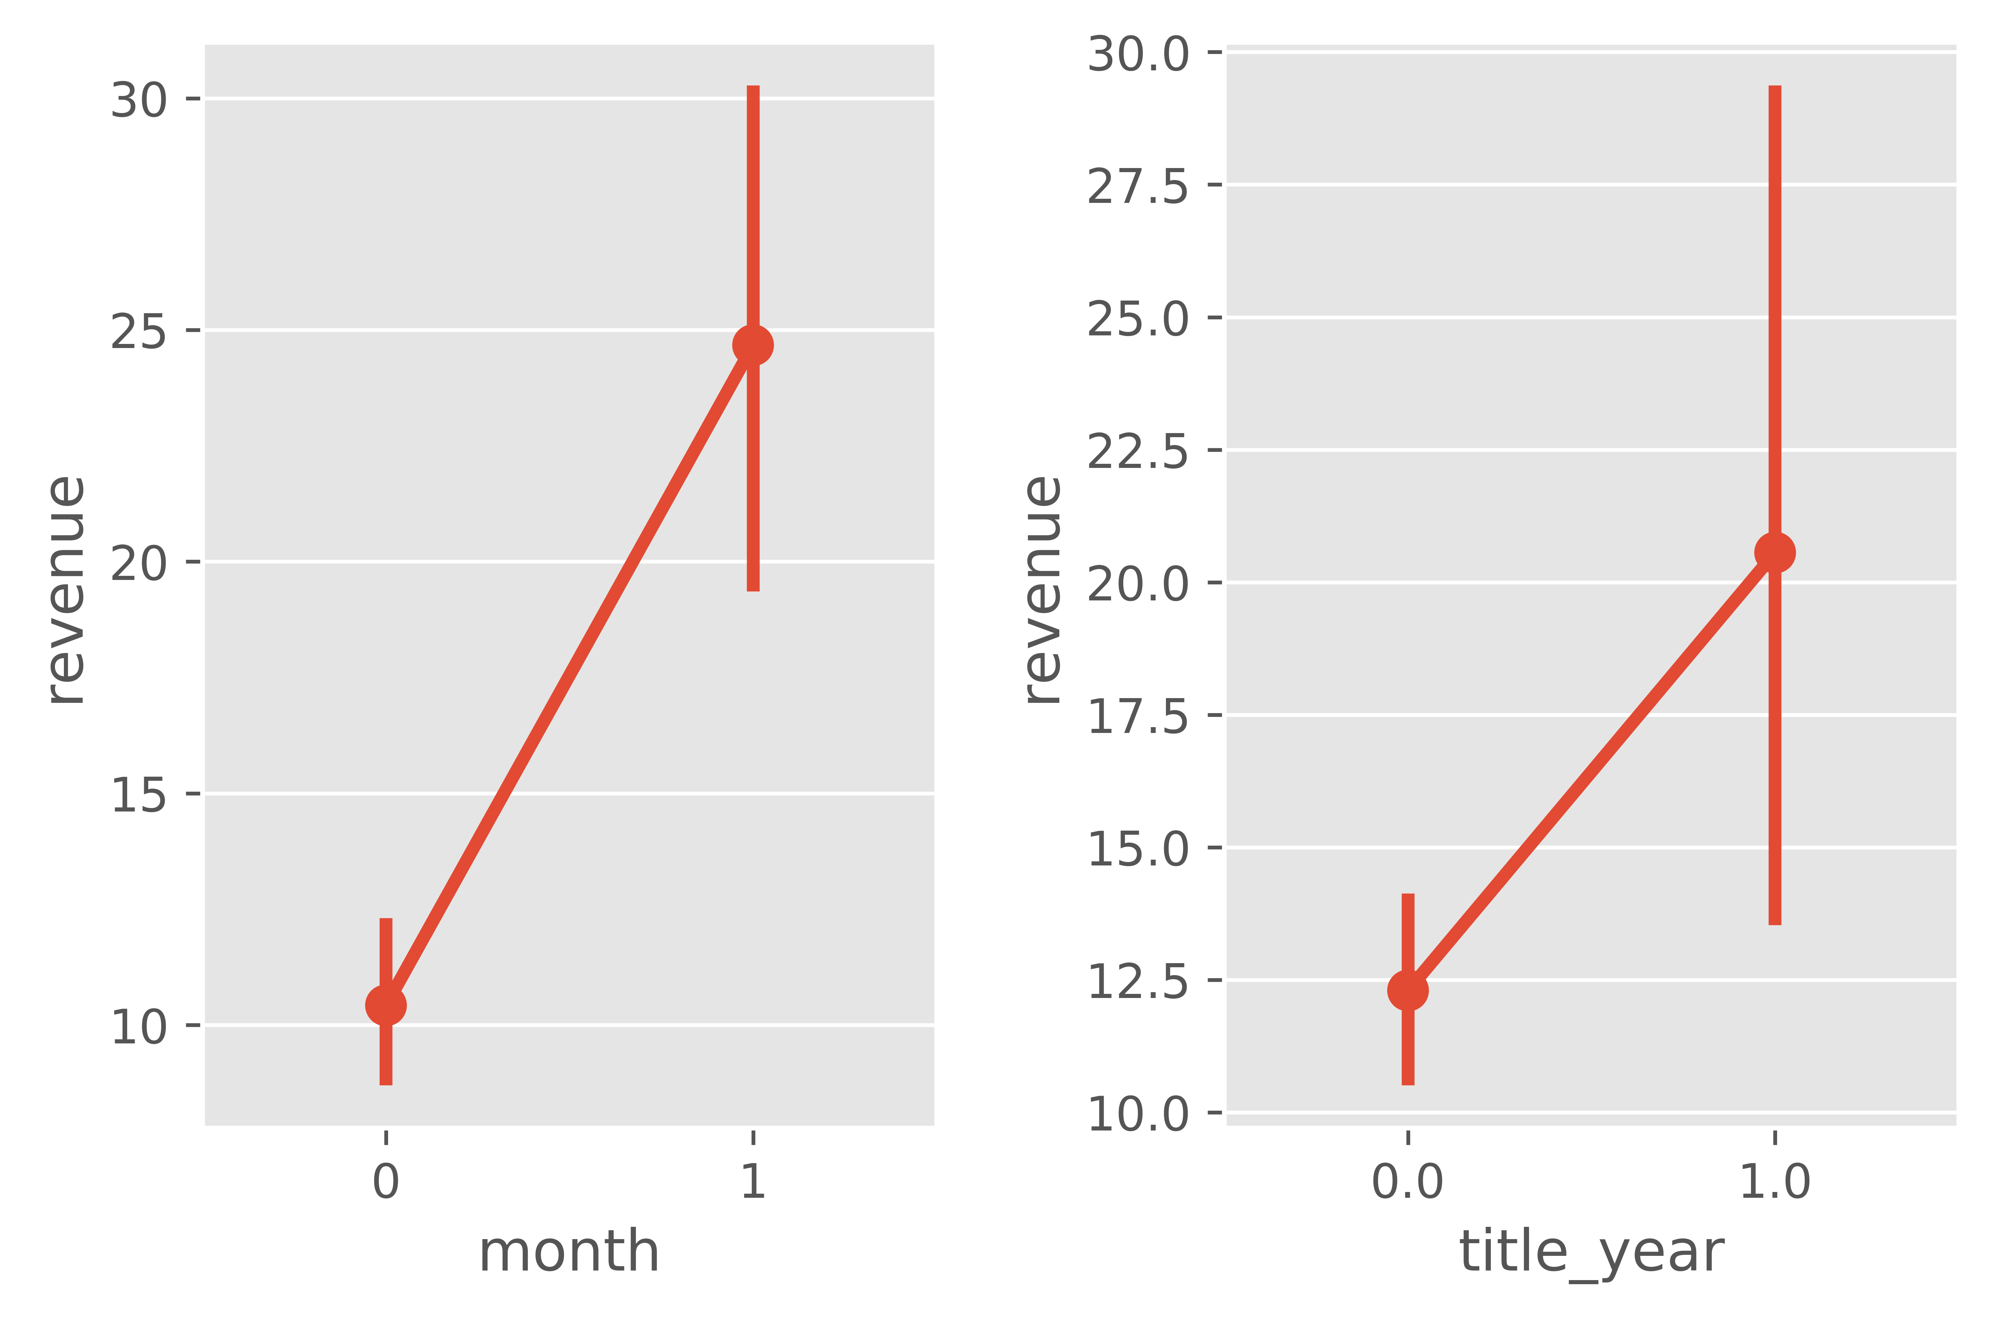
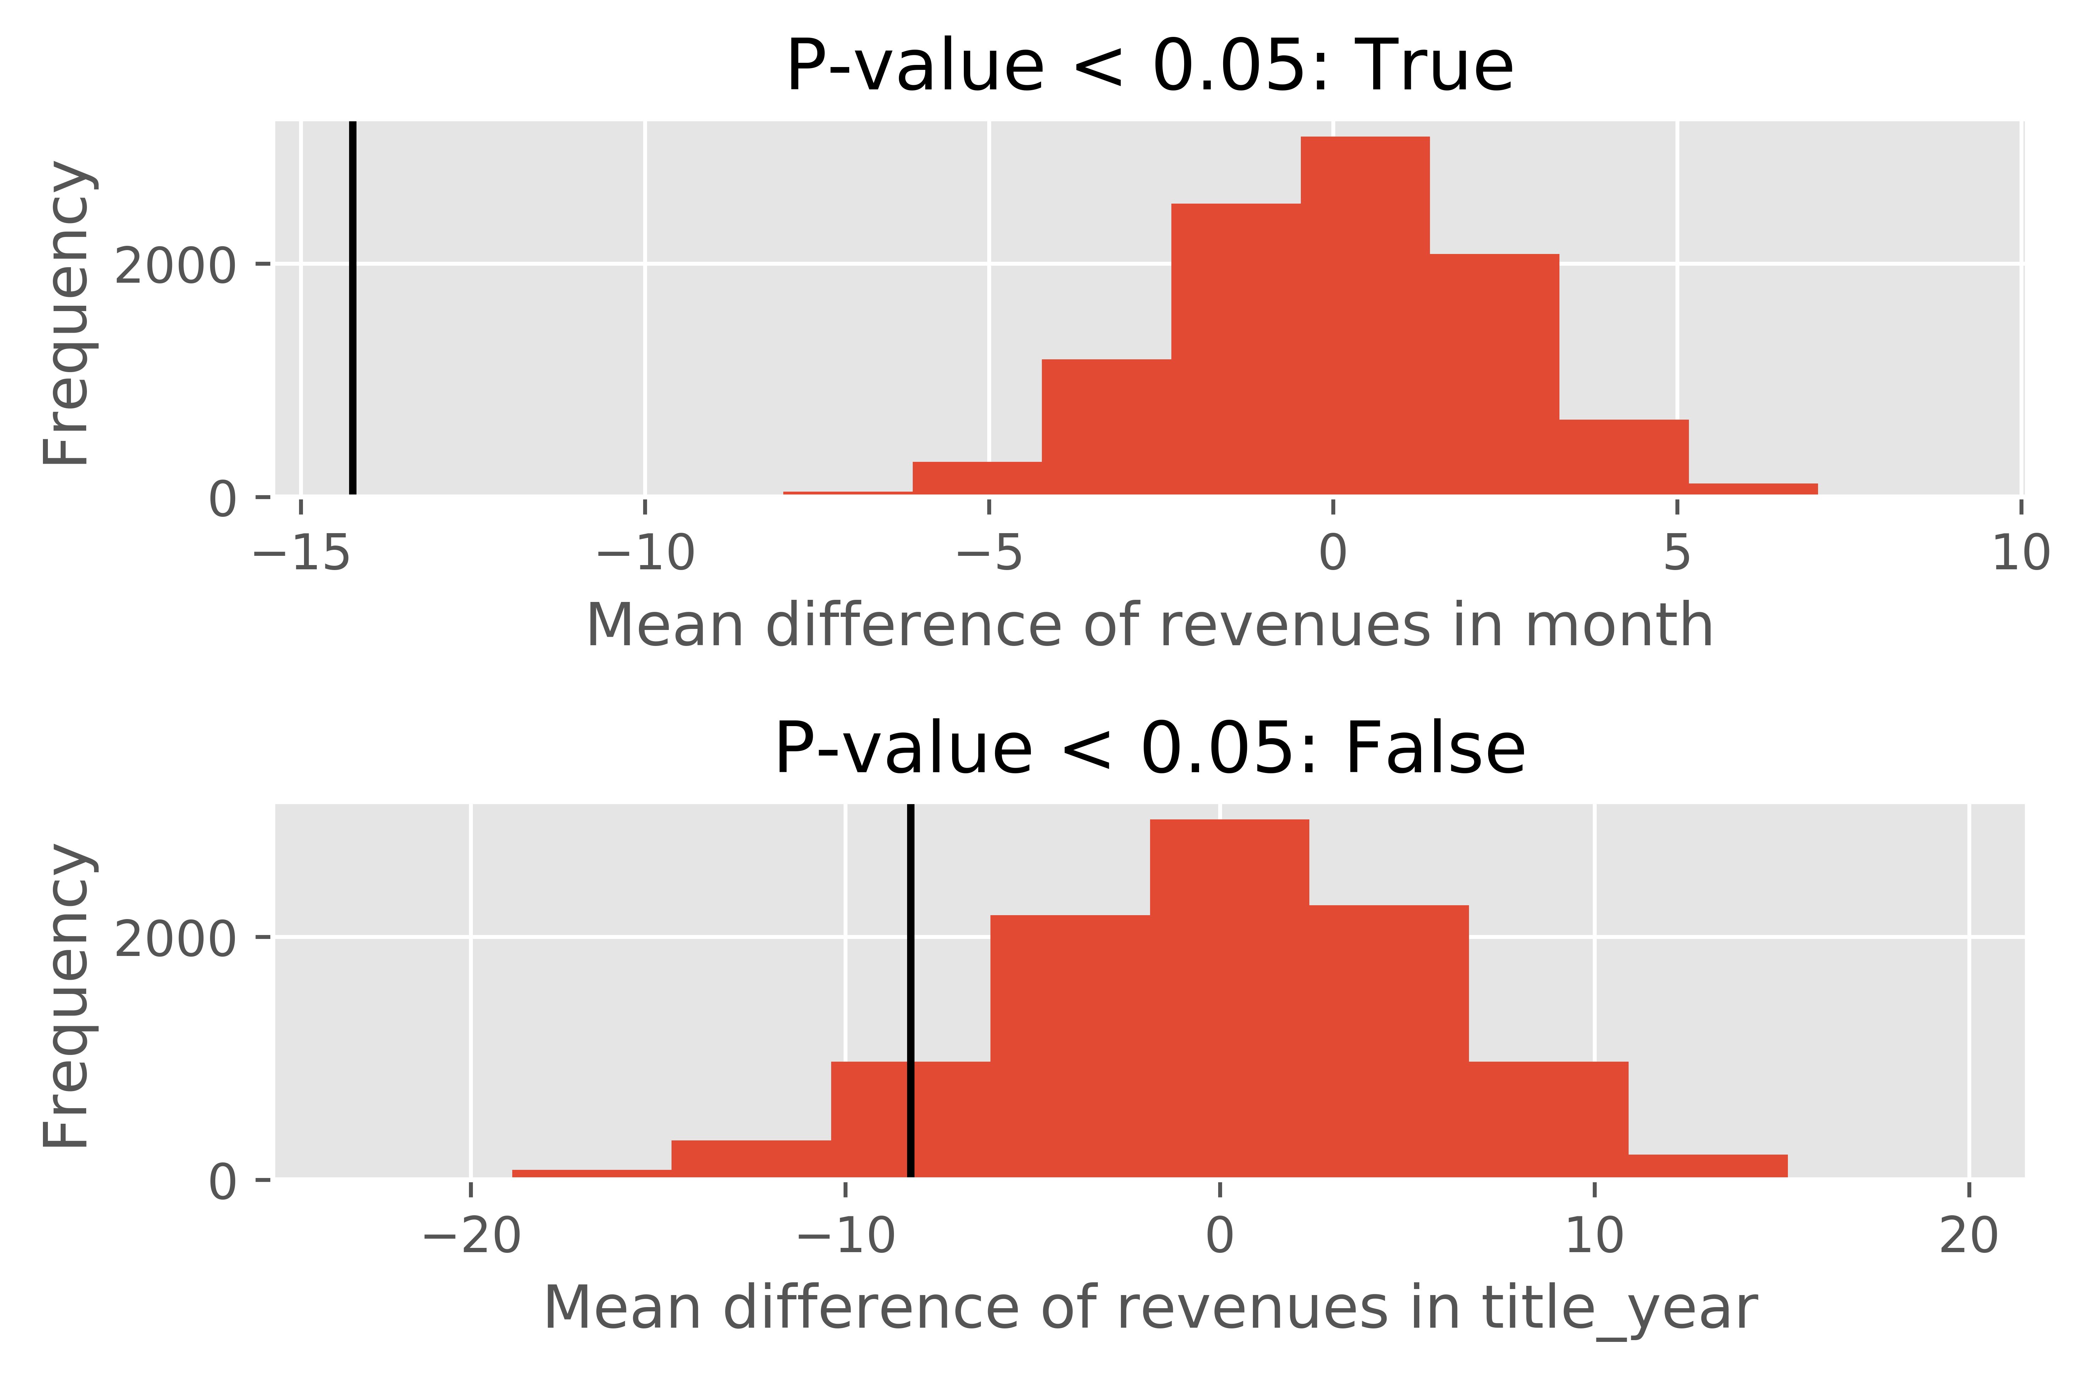
How seasonality and title year affect the revenue?
[Month]
The mean difference is significant.
(1: June and December; 0: the rest of month)
[Title year]
The mean difference is not significant.
(1: after 1966; 0: before 1966)

Slide 13
How genres affect the revenue?
[Significant genre & p-value]
PG-13 0.0067
R 0.0
Adventure 0.0
Animation 0.0001
Comedy 0.0018
Crime 0.0003
Drama 0.0
Family 0.0
Fantasy 0.0002
History 0.0
Sci-Fi 0.0453
Thriller 0.0
War 0.0002

Slide 14
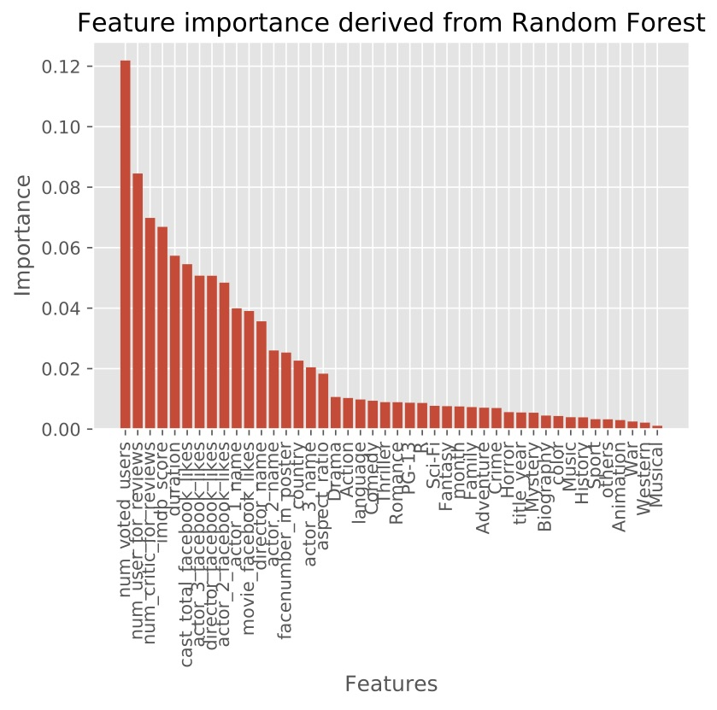
Feature importance
[Top10 features]
Voted users
Users for reviews
Critics for reviews
IMDB score
Social network-related features
Primary actor’s name frequency

Slide 15
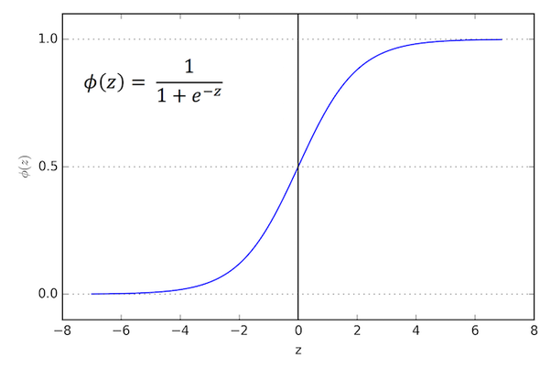
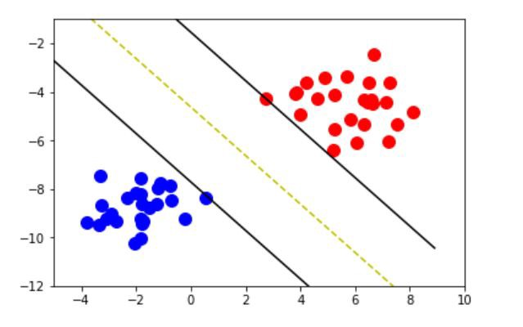

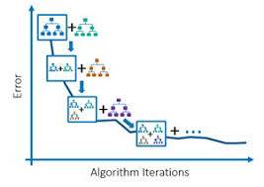
Modeling & results
Logistic
regression
SVM
Random forest
Gradient boosting
 | Linear regression | Logistic regression | SVM | Kernel SVM | KNN | Random forest | Gradient boosting classifier
Accuracy | 0.32 | 0.69 | 0.70 | 0.55 | 0.68 | 0.72 | 0.71

Slide 16
Future plans
Test this dataset in the neural network
Merge more features from different movie dataset
NLP: voters reviews (text)
other score system (Rotten tomatos)

